Slide 1
Atlas Feature Development

Slide 2
Atlas ?
Notes:
What is Atlas ?
->
Why do we need a new Platform ?
Building a web app have 2 options: use a platform, or build your app from scratch.

Slide 3
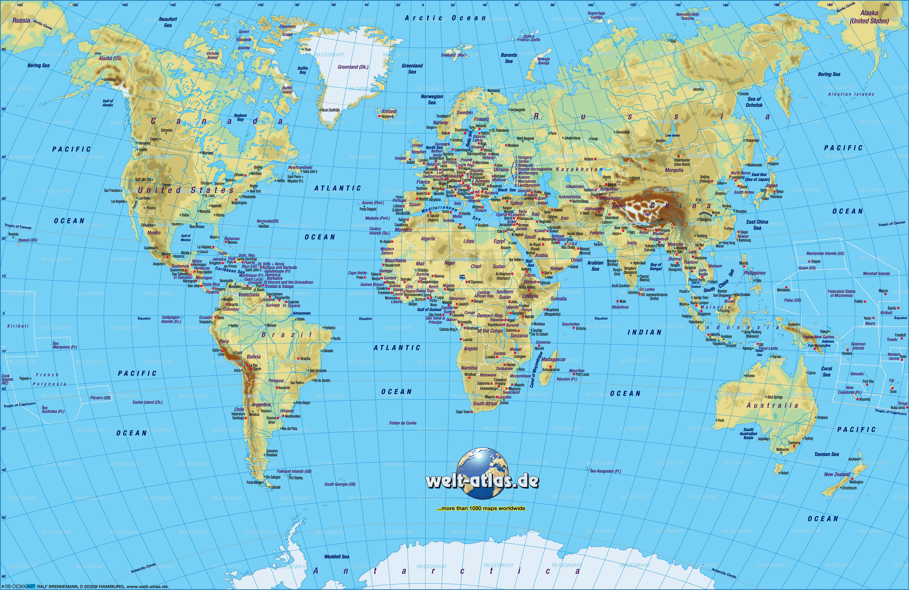
Atlas ?
Notes:
This

Slide 4

Atlas ?
Notes:
That

Slide 5

Atlas ?
Notes:
Him

Slide 6


Atlas
ASB’s next-generation platform
Notes:
What is Atlas ?
->
Why do we need a new Platform ?
Building a web app have 2 options: use a platform, or build your app from scratch.

Slide 7

Notes:
Building from scratch: working with lots of small components -> reinventing the wheel

Slide 8

Notes:
Can alleviate problem by combining smaller nuts and bolts into re-usable widgets…

Slide 9
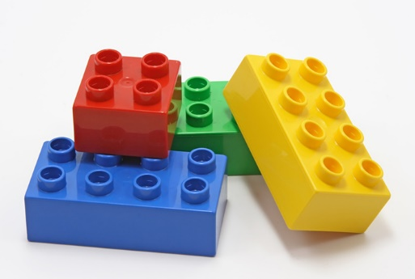
Notes:
…but ideally you want to be scaffolding your application from much larger building blocks (Duplo this case) which take care of the common plumbing concerns: config, logging, authentication, data-access, etc. These building blocks do all the heavy-lifting for your application…

Slide 10

Notes:
…heavy-lifting is one of the main design principals of the Atlas Platform; the platform does the heavy lifting so you can focus on business rather than plumbing.

Slide 11

Notes:
Re-usability is also important. ASP.NET MVC app, pages tightly bound. Only way to move a page is to rip it out.

Slide 12
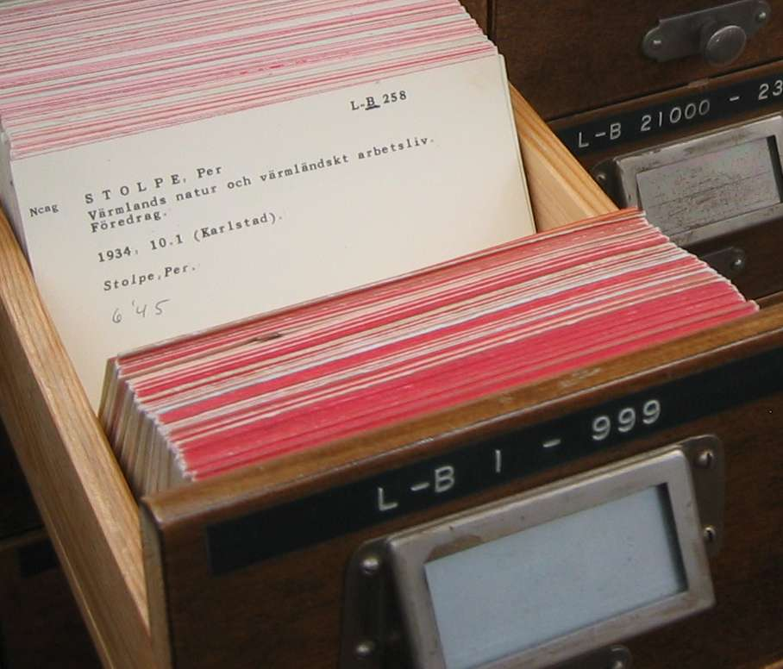
Notes:
Ideally want a more loosely-coupled arrangement which allows features to be re-used between applications.

Slide 13
App Foo
App Bar
Feature 1
Feature 2
Feature 3
Feature 3
Notes:
Atlas allows feature-level re-use by deploying Features as standalone applications. For example…

Slide 14

Customer Service
Account Service
Calendar Control
Product-Request
Service
Products Service
Notification
Service
Addresses Service
Payments Service
Email Question
Text Question
Transfer Service
Notes:
Also have re-usability within features by maintaining a growing repository of re-usable widgets (Lego): for example…

Slide 15
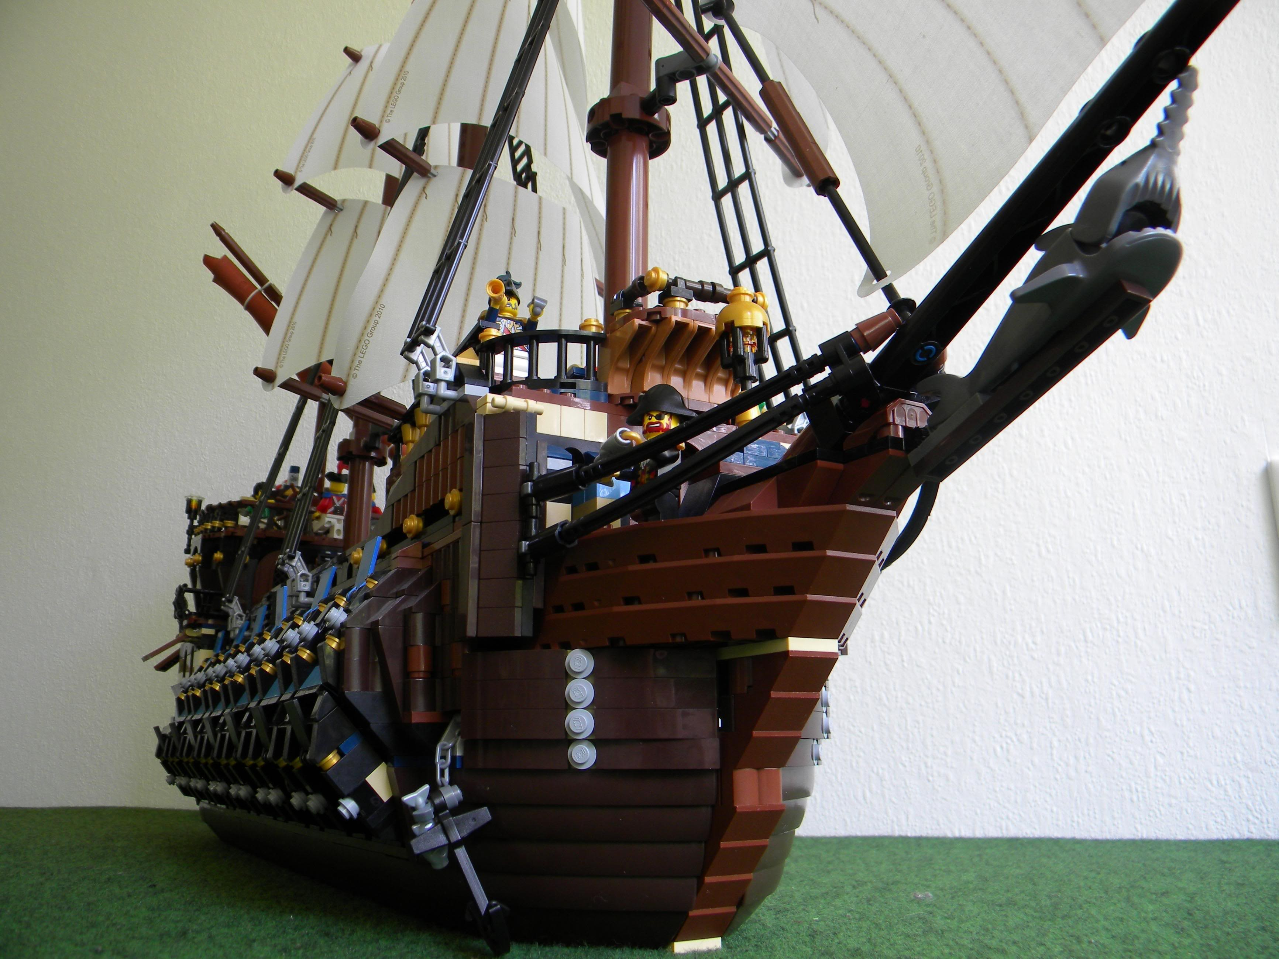
Notes:
Lastly, we want our apps to be responsive; Desktop

Slide 16
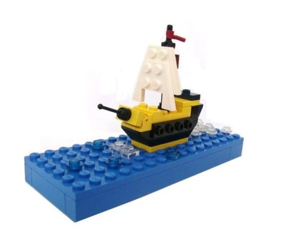
Notes:
Tablet

Slide 17
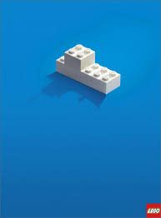
Notes:
Mobile. Good experience…

Slide 18

Notes:
..not so good.

Slide 19
Container
5
1
2
IAM
Platform Services
Feature 1
Feature 2
3
Transactions
Payments
Product-Requests
Accounts
Transfers
Products
…
Feature 3
Layer 7 (APIs)
4
Middleware
HOST
Onyx
Notes:
10,000ft view of the Atlas Platform.
Containers & Features: Containers being a hosting environment for Features.
Platform Services: provides configuration and run-time support for Containers
APIs: RESTful services for providing data to Features.

Slide 20



Development Stack
MVC
Toolkit
Responsive
Containers & Features
Helix
Notes:
Likely suspects in SPA development

Slide 21






Dev-ops
Source Control
Build Automation
Release Management

Slide 22
My ASB
Notes:
Pilot Atlas application. Eventual replacement to FNC.

Slide 23
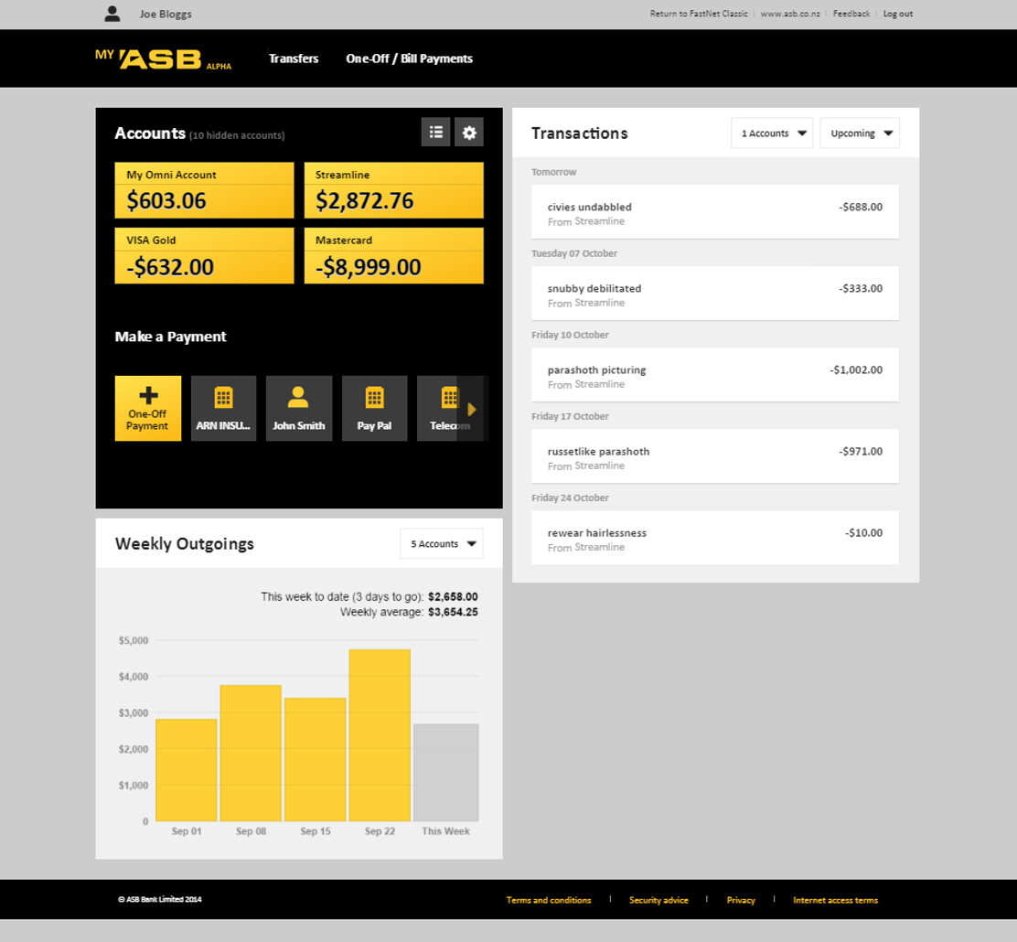
1
2
3
Notes:
Home page, 3 Features. Note, each Feature deployed and versioned independently.

Slide 24
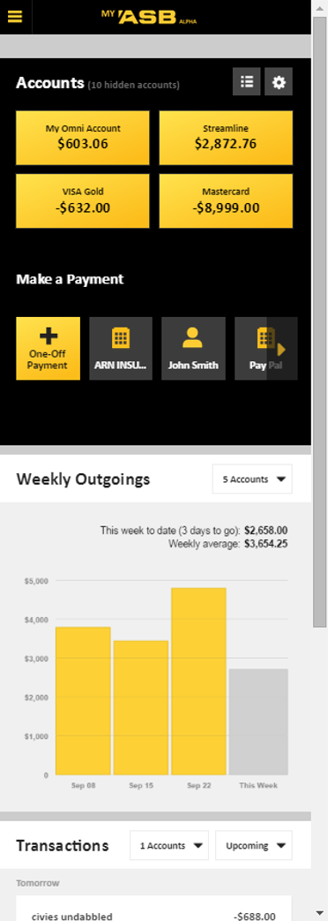
1
2

Slide 25
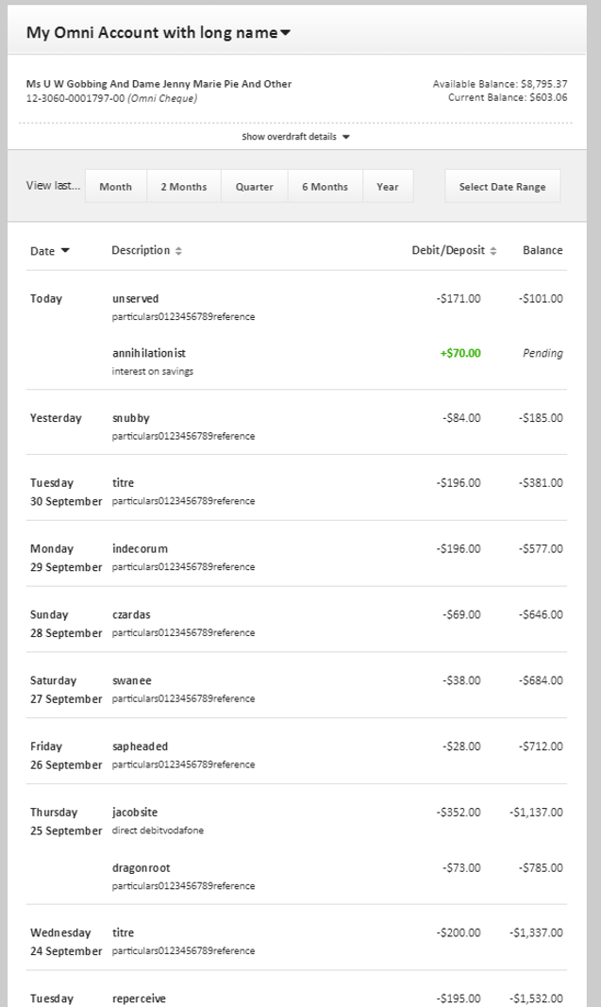

Slide 26
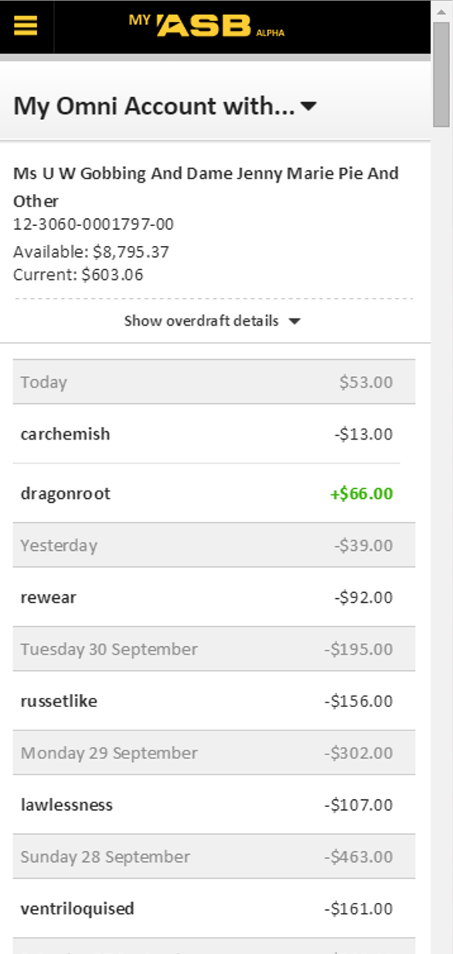

Slide 27
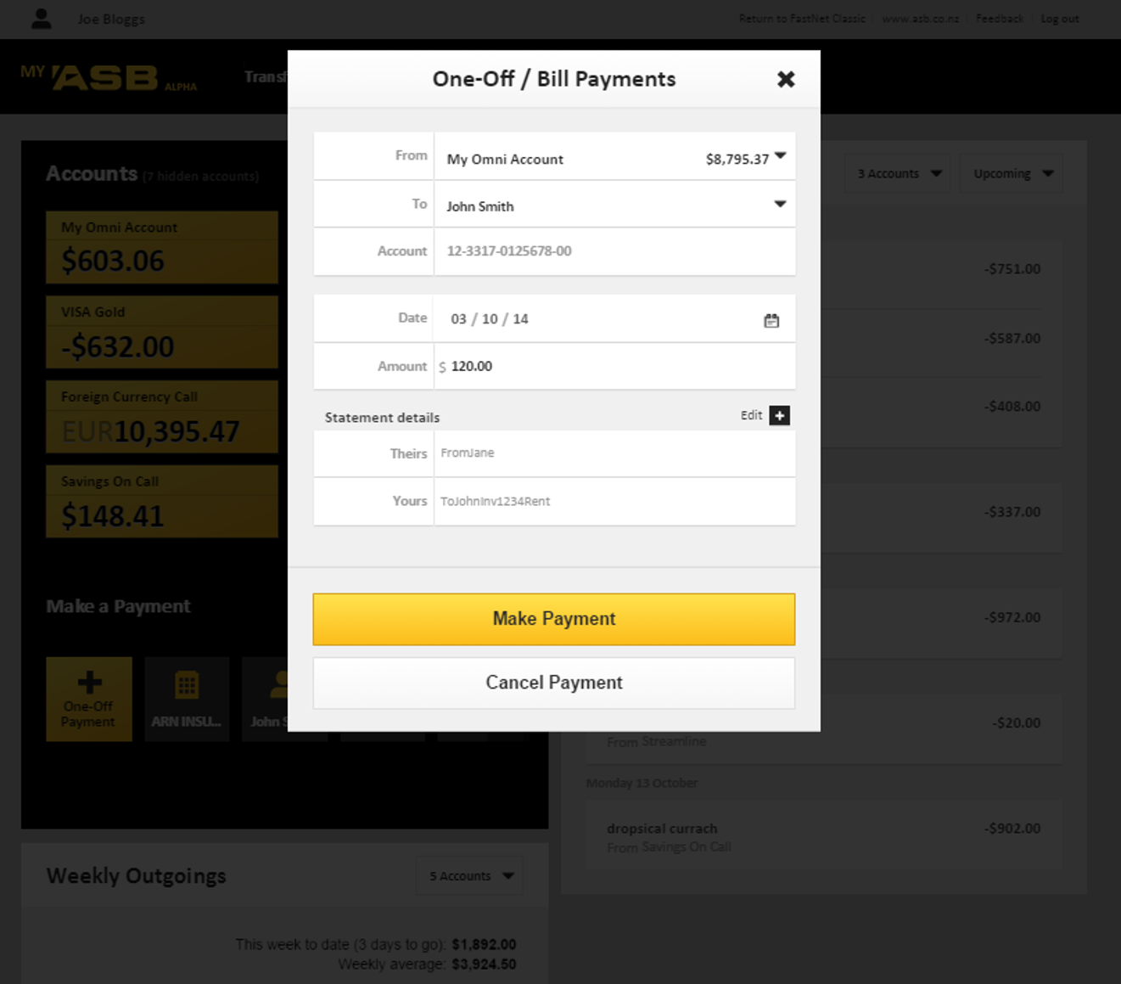
Notes:
…can also be presented as modal popups (lightboxes)

Slide 28
Digital Sales
Fulfilment
Notes:
Most recent Atlas deployment to go to Production. Suite of application forms for applying for various ASB products

Slide 29
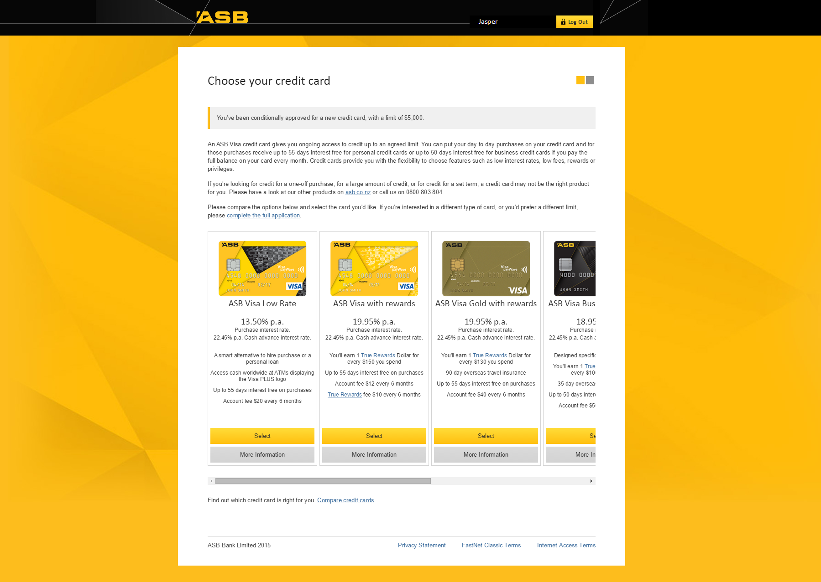
Notes:
Example: CALs – applying for credit cards (pre-approved limit). Single-page Feature with multiple views.

Slide 30
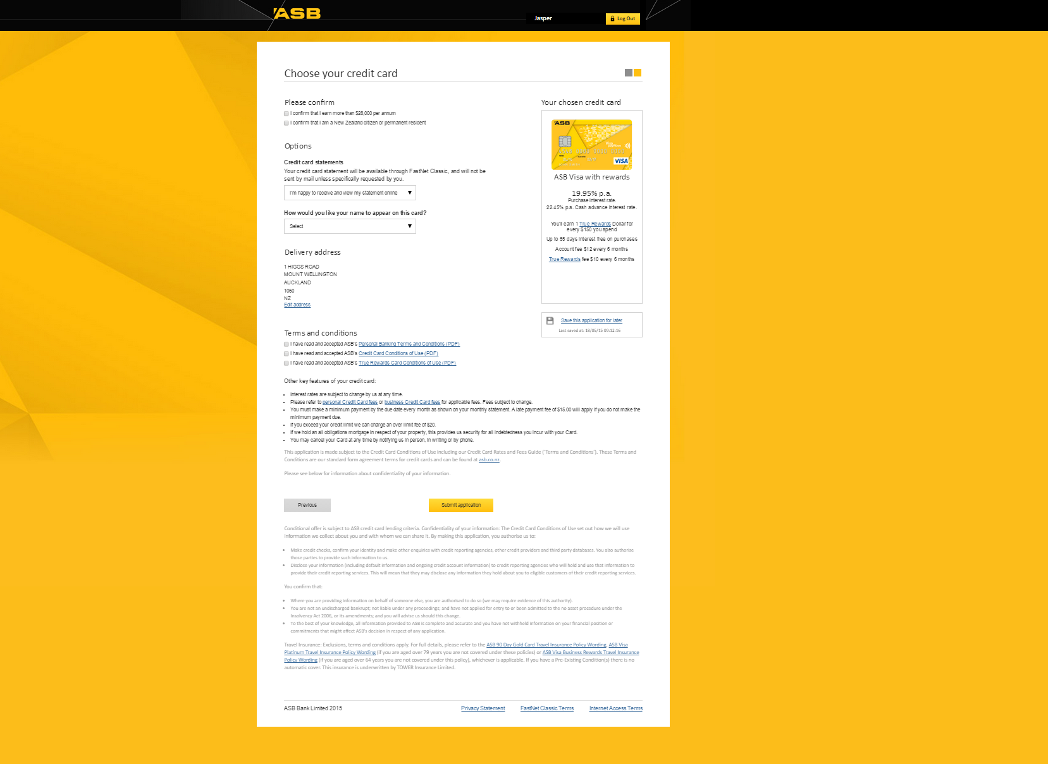

Slide 31
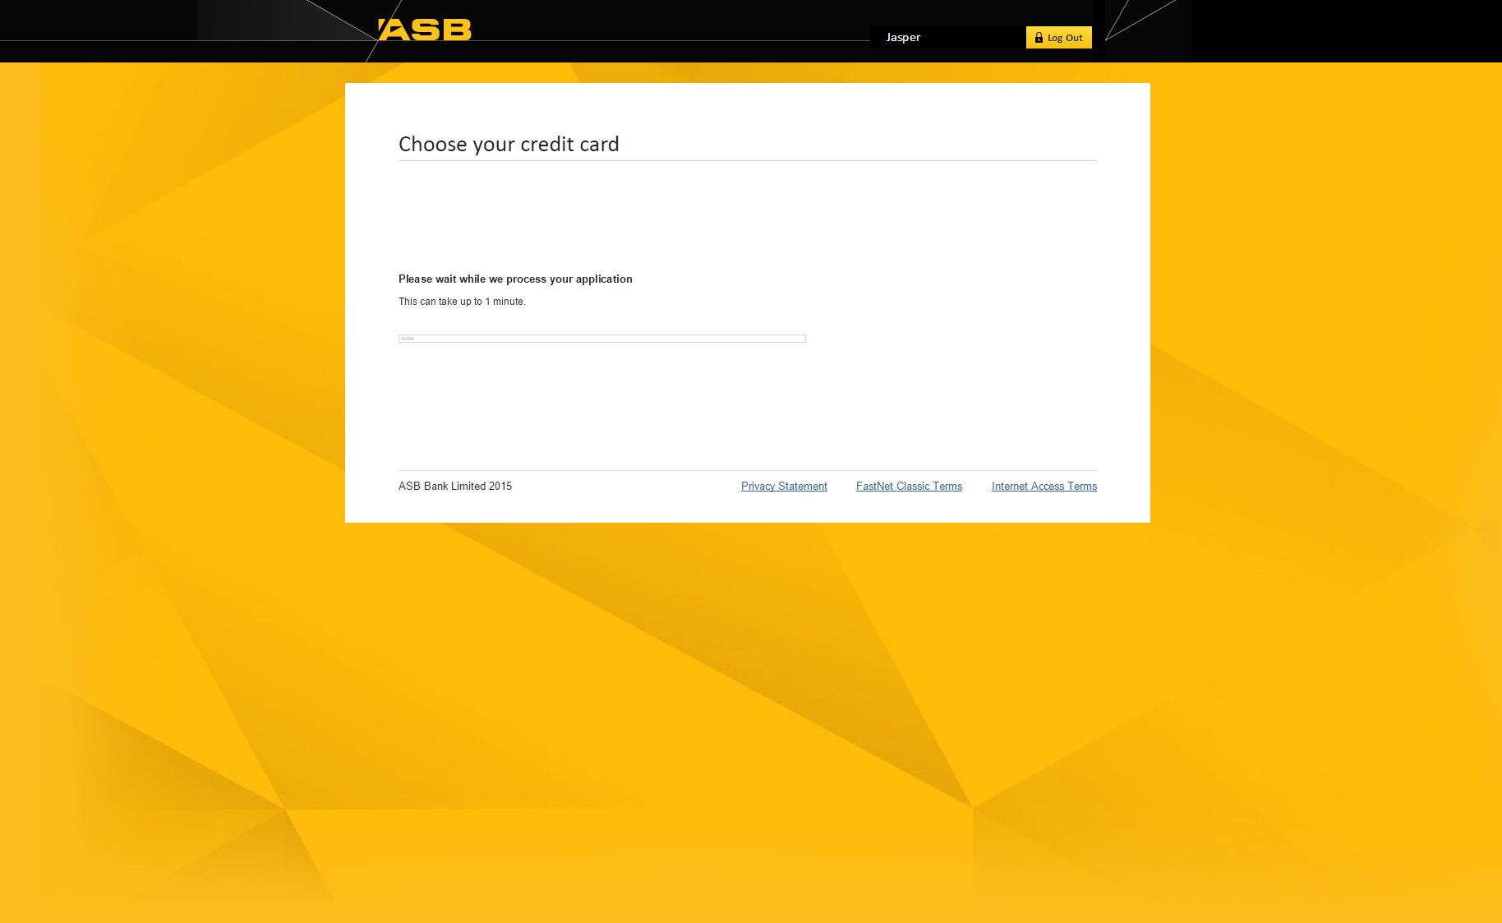

Slide 32
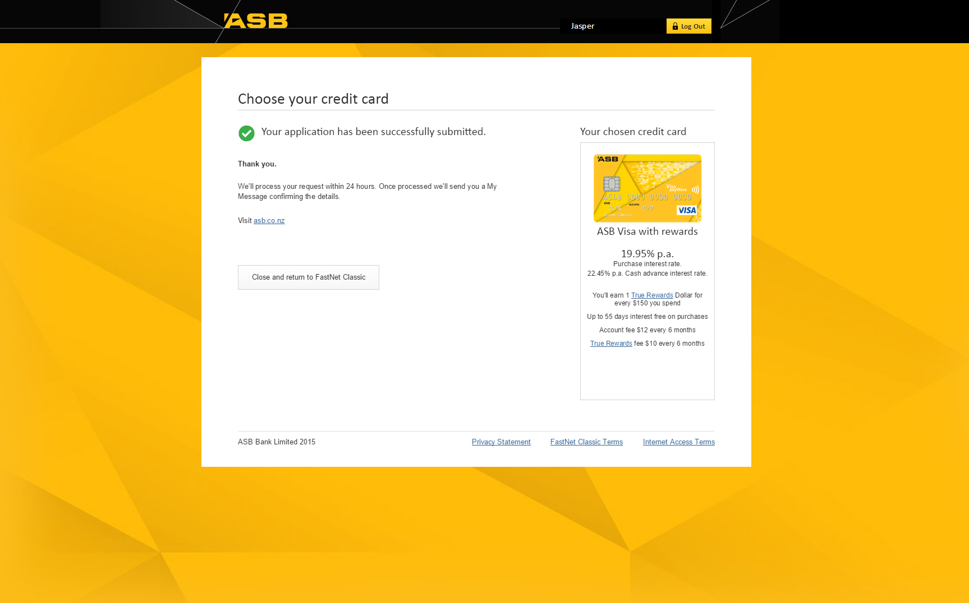

Slide 33

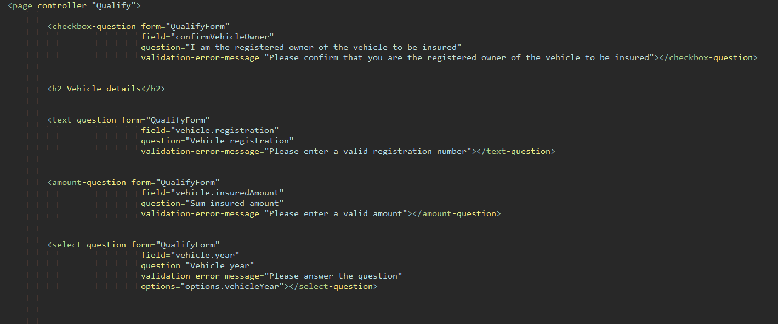
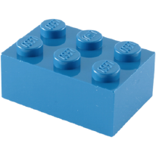
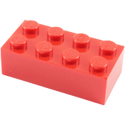
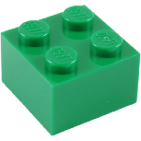

Notes:
Finally. Widget repository to allow Lego-brick style development of Features. Example of using ng directives.

